Slide 1
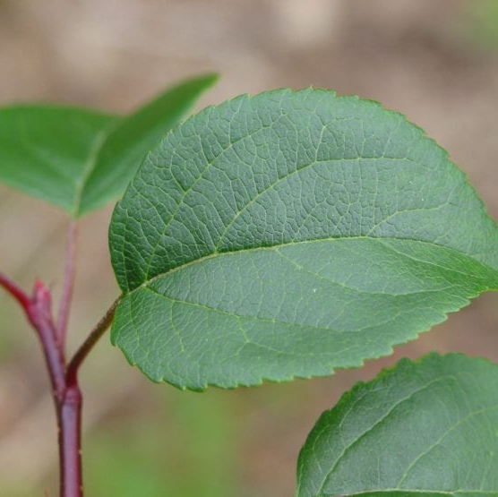
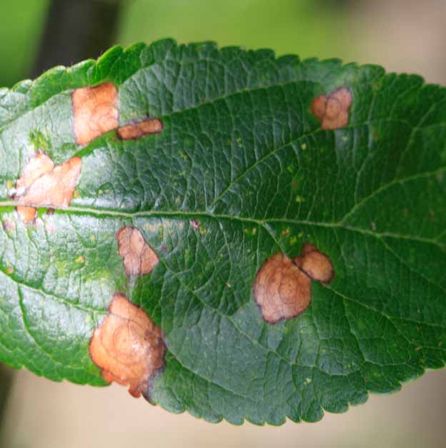
Crop Disease Detection

Slide 2
Table of contents
Introduction
Influences
01
02
Surmount
Integration with ML
03
04

Slide 3
1
Introduction

Slide 4
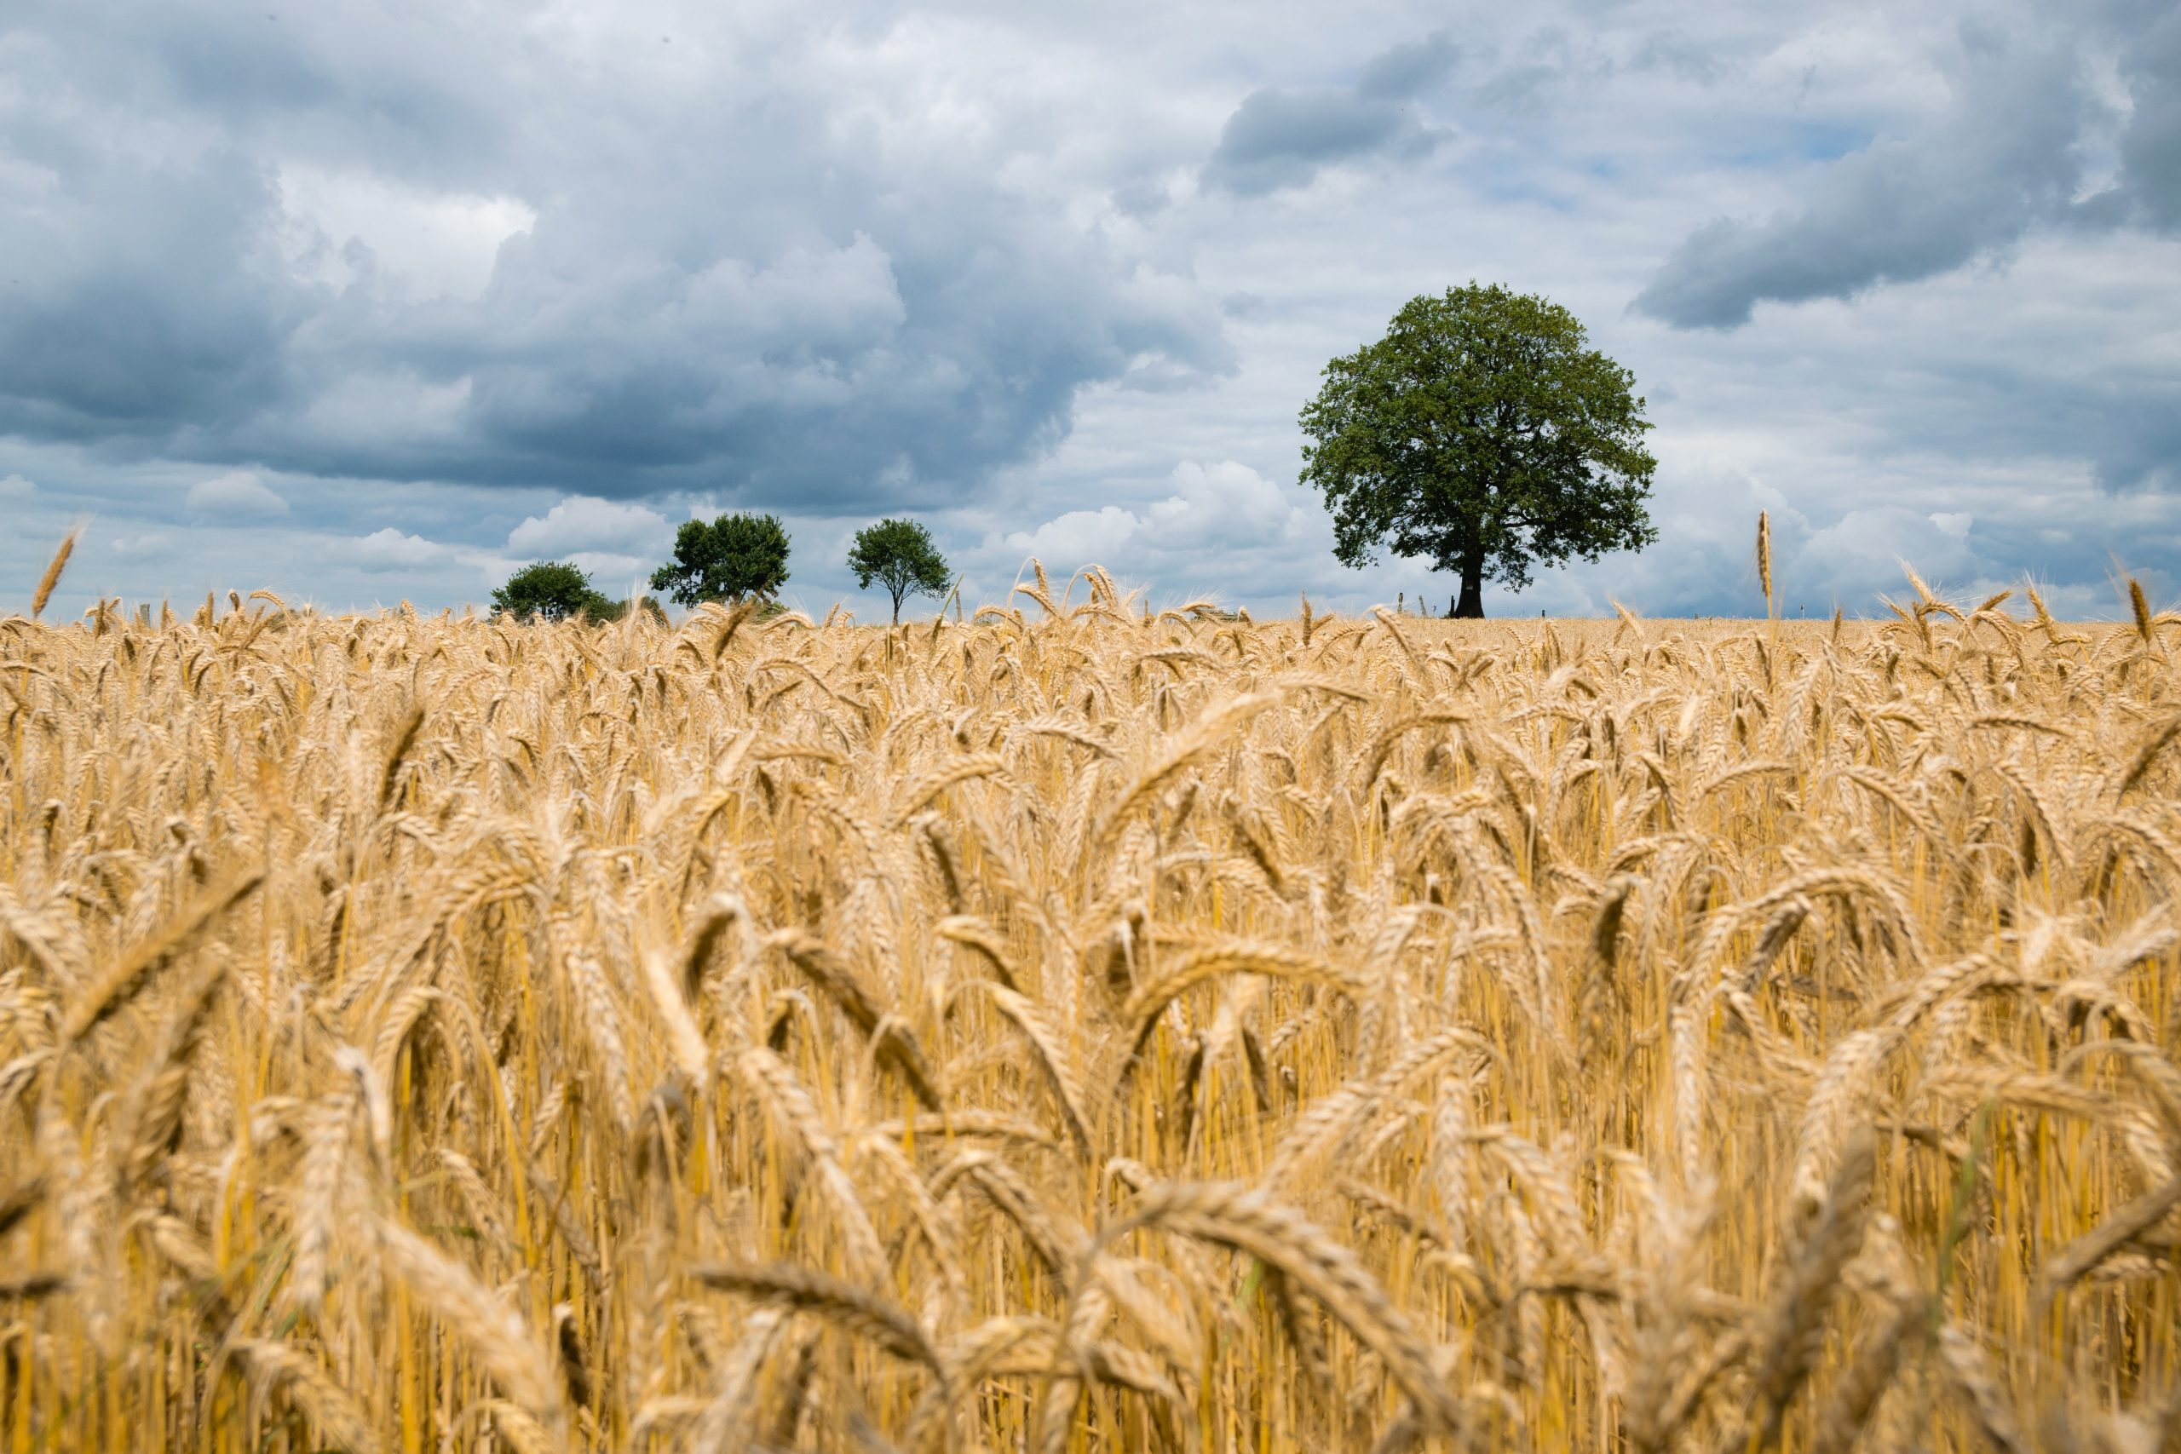
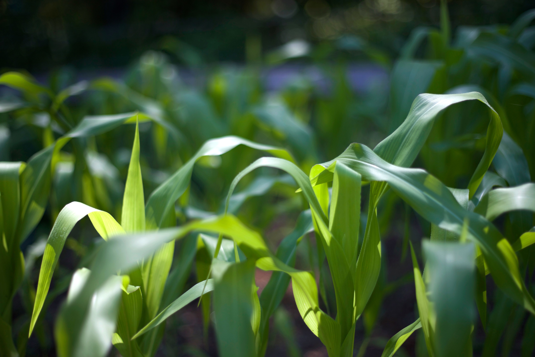
Crop diseases are ailments caused by pathogens like fungi, bacteria, viruses, nematodes, and abiotic factors, affecting plants' health and productivity. They exhibit symptoms such as leaf spots, wilting, discoloration, and stunted growth. Diseases spread through various means and require preventive measures like sanitation, crop rotation, and use of resistant cultivars for effective management. Early detection and accurate diagnosis are crucial for minimizing economic losses in agriculture.
Crop disease detection is a vital component of modern agriculture, aimed at identifying and diagnosing diseases affecting crops promptly and accurately. Early detection enables farmers to implement timely interventions, minimizing yield losses and ensuring food security. With advancements in technology, particularly in areas such as remote sensing, image processing, and machine learning, innovative methods have emerged for detecting crop diseases efficiently. These techniques utilize various data sources, including satellite imagery, drone surveillance, sensor technology, and historical data, to monitor crop health and detect abnormalities indicative of disease presence.

Slide 5
2
Influences

Slide 6
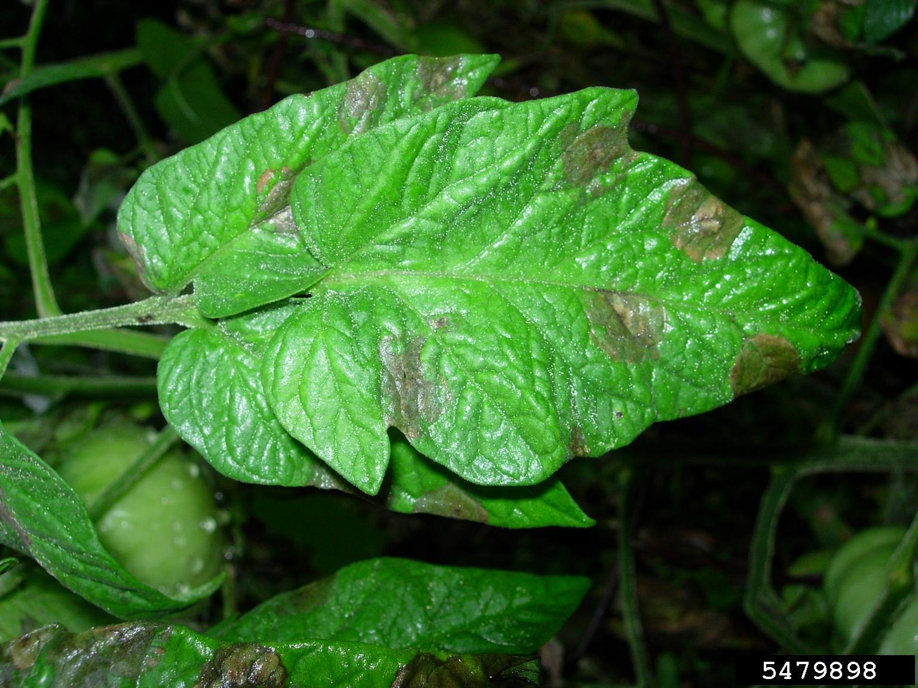
Environmental Conditions: Weather elements such as temperature, humidity, rainfall, and wind speed play a crucial role in creating favorable conditions for disease development. For instance, high humidity levels can promote fungal diseases, while prolonged periods of rain can facilitate the spread of waterborne pathogens.
Soil Health: The health and composition of soil directly impact crop susceptibility to diseases. Imbalanced soil nutrients, soil pH, and presence of pathogens in the soil can all influence disease occurrence. Poor soil drainage can also exacerbate certain diseases by creating waterlogged conditions favorable for pathogen growth.
Crop Varieties and Genetics: Different crop varieties exhibit varying levels of resistance or susceptibility to diseases. Plant breeders develop resistant varieties through genetic selection to combat prevalent diseases. However, the continuous evolution of pathogens can render previously resistant varieties vulnerable over time.
This Photo by Unknown Author is licensed under CC BY

Slide 7
Cultural Practices: Farming practices such as crop rotation, tillage methods, planting density, and irrigation management can either mitigate or exacerbate disease outbreaks. Crop rotation, for instance, disrupts the life cycle of pathogens, reducing their buildup in the soil and minimizing disease incidence.
Pest and Pathogen Pressure: The presence and population dynamics of pests and pathogens within agricultural ecosystems significantly impact disease occurrence. Pests can vector pathogens or directly damage plants, making them more susceptible to infections. Moreover, the interaction between different pests and pathogens can create complex disease dynamics.
Chemical Inputs: The use of pesticides, fungicides, and fertilizers can influence disease dynamics in agricultural systems. While these inputs may control certain pathogens, they can also disrupt ecological balances, leading to secondary pest outbreaks or the development of pesticide-resistant strains.
Global Trade and Climate Change: Globalization and climate change contribute to the spread of exotic pathogens to new regions and alter local environmental conditions, respectively. Changes in temperature and precipitation patterns can shift disease distribution ranges and favor the emergence of novel diseases in previously unaffected areas.

Slide 8
3
Surmount

Slide 9
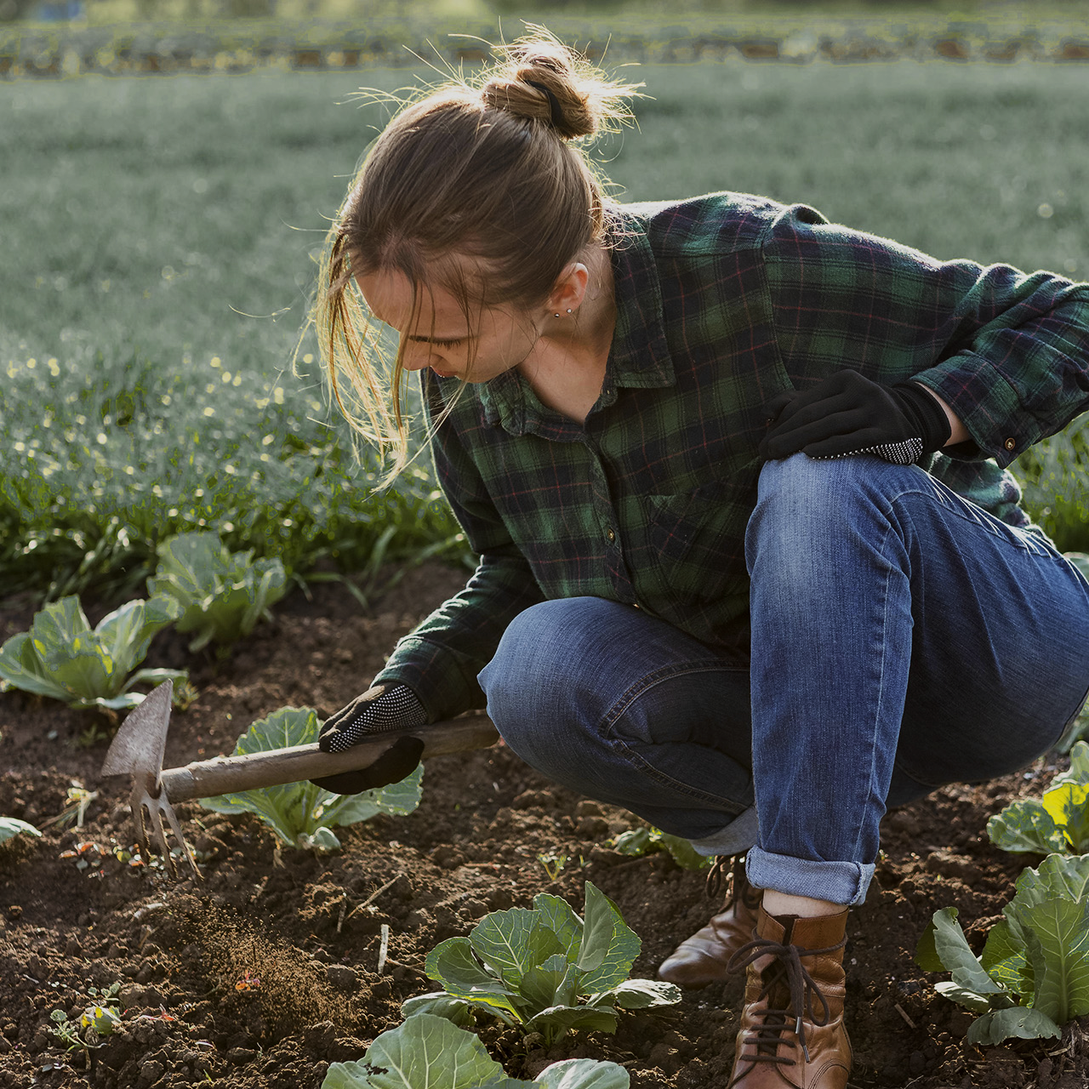
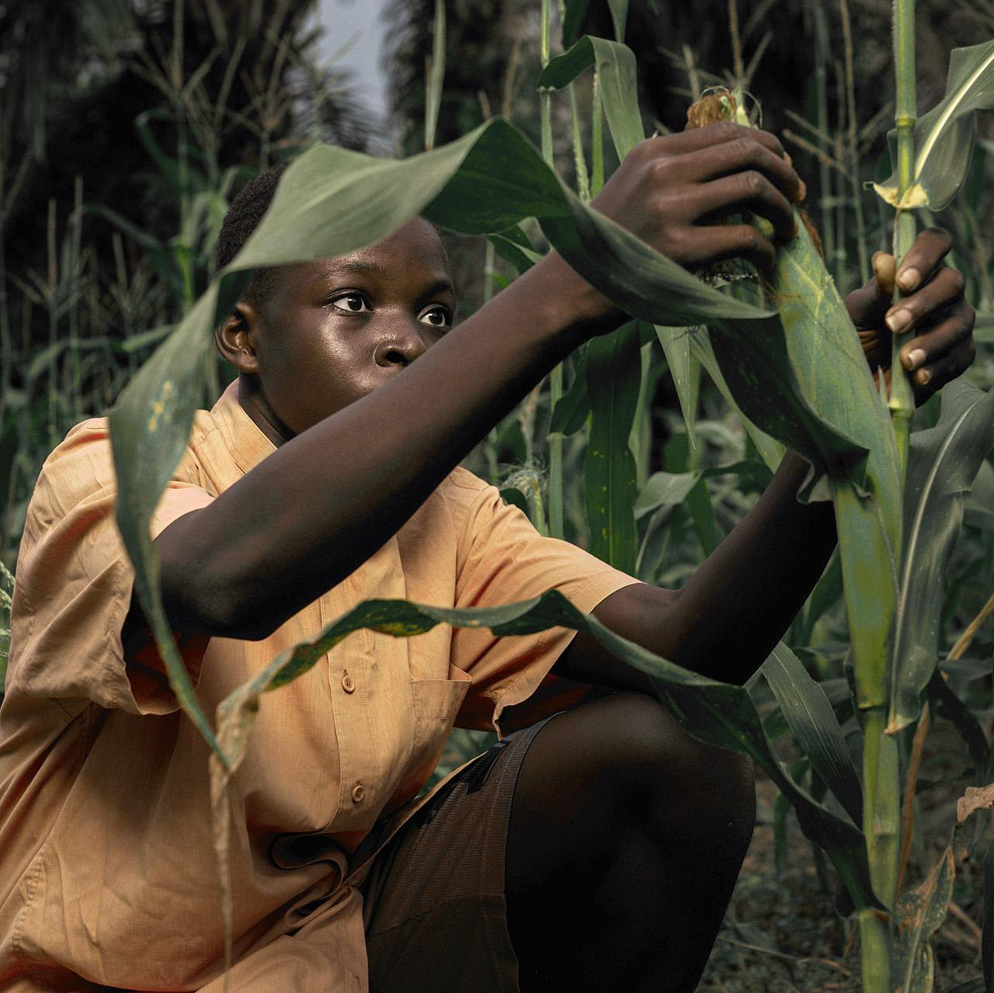
Awesome agriculture

Slide 10
Environmental Management:
Implementing proper irrigation techniques to maintain optimal soil moisture levels and prevent waterlogging.
Using mulching to regulate soil temperature and moisture, reducing the risk of certain fungal diseases.
Installing windbreaks and implementing shelterbelt systems to mitigate wind damage and reduce the spread of airborne pathogens.
Soil Health Improvement:
Conducting regular soil testing to assess nutrient levels and pH, and then applying appropriate amendments to optimize soil health.
Adopting sustainable soil management practices such as cover cropping, composting, and minimal tillage to enhance soil structure and biological activity, thereby reducing disease pressure.
Crop Selection and Genetic Resistance:
Choosing crop varieties with natural resistance or tolerance to prevalent diseases.
Supporting breeding programs that develop disease-resistant cultivars through conventional breeding or genetic engineering techniques.
Diversifying crop rotations to include resistant species or varieties, interrupting disease cycles and reducing pathogen buildup in the soil.

Slide 11
Improved Cultural Practices:
Implementing proper sanitation measures to remove crop debris and minimize inoculum sources.
Adjusting planting dates and spacing to optimize plant health and reduce disease spread.
Promoting balanced nutrient management to prevent nutrient imbalances that can weaken plants and make them more susceptible to diseases.
Integrated Pest and Disease Management (IPM):
Implementing IPM strategies that prioritize non-chemical control methods such as biological control, habitat manipulation, and crop diversification.
Monitoring pest and disease populations regularly to detect outbreaks early and inform timely intervention decisions.
Employing targeted pesticide or fungicide applications only when necessary, following integrated pest management principles to minimize environmental impacts and mitigate the risk of pesticide resistance.
Climate Resilience and Adaptation:
Adopting climate-smart agricultural practices that enhance resilience to climate variability and extremes.
Investing in infrastructure and technologies that improve water management and reduce vulnerability to droughts or floods.
Participating in climate adaptation programs and accessing climate information services to make informed decisions regarding crop management and risk mitigation.

Slide 12
4
Integration with ML

Slide 13
Image Recognition: ML algorithms, particularly convolutional neural networks (CNNs), are trained on vast datasets of images depicting healthy and diseased crops. These algorithms learn to distinguish between different types of diseases based on visual features such as leaf discoloration, lesions, or other symptoms. Once trained, these models can classify new images of crops as healthy or infected with a specific disease, enabling rapid and accurate diagnosis in the field.
Remote Sensing: ML algorithms are applied to analyze satellite or drone imagery to monitor crop health over large areas. By leveraging spectral signatures and other data captured by remote sensors, these algorithms can detect subtle changes in vegetation that may indicate the presence of diseases, nutrient deficiencies, or other stressors. ML models trained on such data can provide early warnings of disease outbreaks, allowing farmers to take timely preventive measures.
Sensor Technology: ML algorithms are integrated with sensor technology, such as IoT devices or handheld sensors, to monitor environmental parameters (e.g., temperature, humidity) and physiological indicators of crop health (e.g., chlorophyll content, leaf moisture). By analyzing real-time sensor data, ML models can detect deviations from normal conditions that may signal the onset of disease, enabling proactive interventions before symptoms become visually apparent.

Slide 14
Data Fusion and Decision Support Systems: ML techniques are used to integrate heterogeneous data sources, including weather data, soil information, historical disease records, and agronomic practices. By combining these datasets, ML-based decision support systems can generate personalized recommendations for disease prevention and management tailored to specific crops, locations, and environmental conditions.
Predictive Modeling: ML algorithms are trained on historical disease data to develop predictive models that forecast the likelihood and severity of disease outbreaks in the future. By considering factors such as weather patterns, crop phenology, and disease dynamics, these models can anticipate disease risks and inform proactive strategies for disease management, such as adjusting planting schedules or optimizing fungicide applications.
Disease Tracking and Monitoring: ML algorithms are employed to analyze and interpret data from various sources, including social media, agricultural extension reports, and surveillance networks, to track the spread of diseases in real-time. By extracting relevant information and identifying spatial-temporal patterns, ML-based systems can provide early warnings of disease epidemics and support targeted interventions to contain outbreaks.

Slide 15
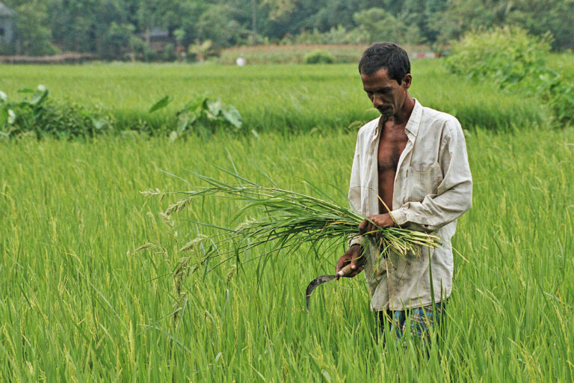
A picture is worth a thousand words

